Slide 1
GDS analysis
Pablo Sebastián Rodriguez, Andrés Tenesaca Burgos

Slide 2

Source GDS packages
Platforms
Samples
Series
Datasets

Slide 3

Analysis technology

Slide 4
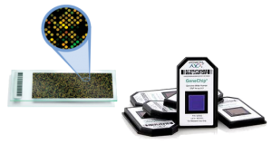
Gene chips

Slide 5


Language & framework

Slide 6
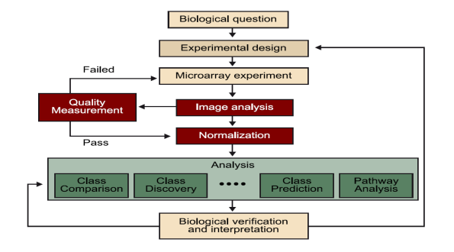
Pipeline

Slide 7
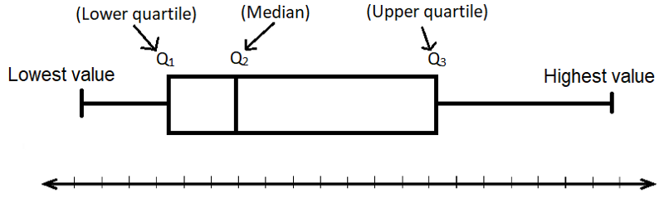
Scatter plot

Slide 8
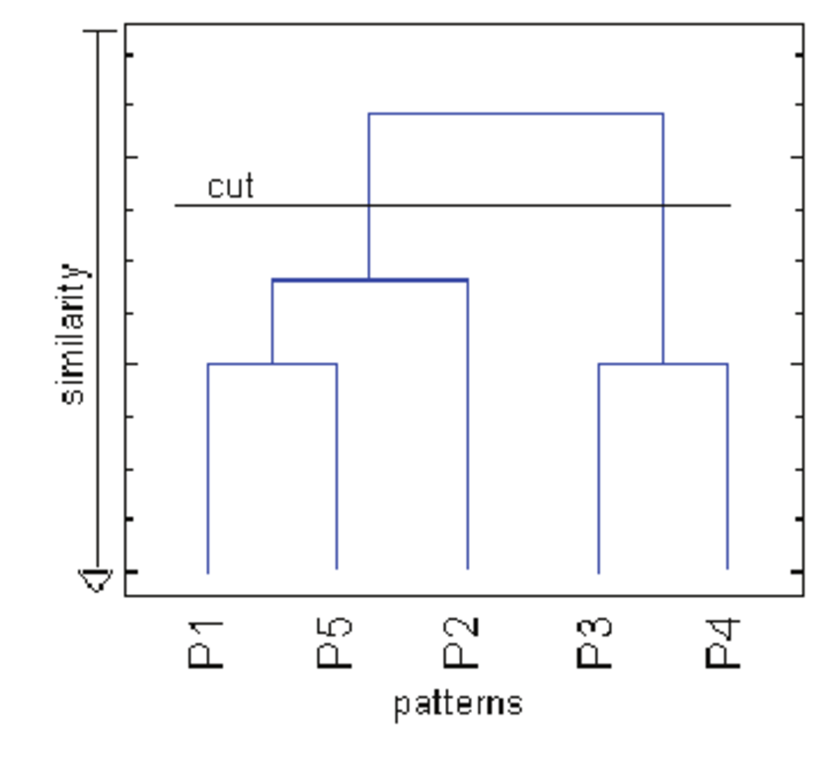
Dendrogram plot

Slide 9
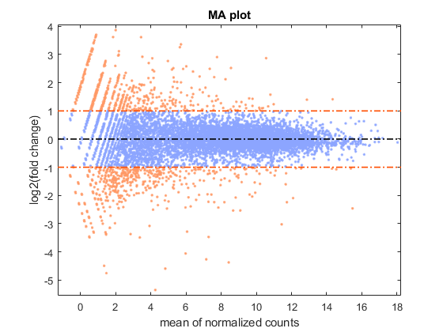
MA plot

Slide 10
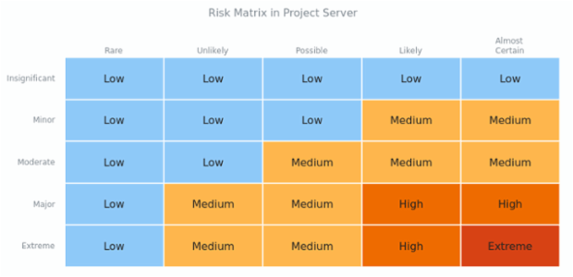
HeatMap plot

Slide 11
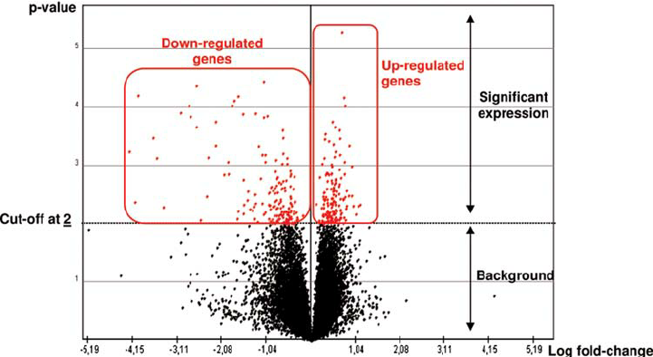
Volcano plot

